Slide 1
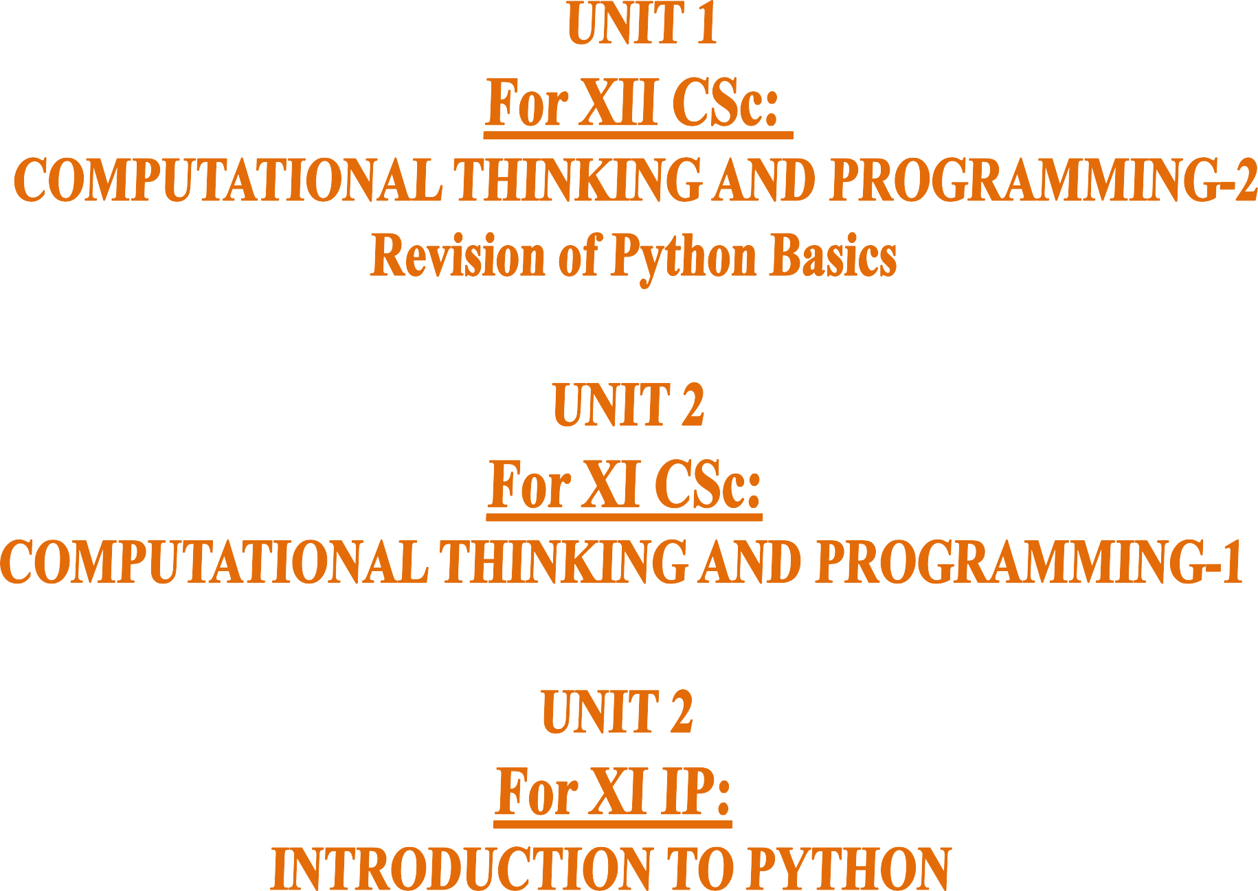

Slide 2






( Learning Outcomes ) ☺
LIST in Python
CONTENTS
XI CS 2020-21
→ Lists Introduction: Definition, Creation of a list, Traversal of a list.
→ Operations on a list – concatenation/joining, repetition/replication, membership, Comparison of Lists;
→ Functions/methods–len(), list(),append(), extend(), insert(), count(), index(), remove(), pop(), reverse(), sort(),min(), max(), sum()
→ Lists Slicing;
→ Nested lists;
→ finding the maximum, minimum, mean of numeric values stored in a list
→ linear search on list of numbers
→ counting the frequency of elements in a list
XI IP 2020-21
Lists: list operations - creating, initializing, traversing and manipulating

Slide 3






Slide 4
What is a LIST ?
CONTENTS
→Lists Intro:
List Definition
Indexing in a List Creation of a list Traversal of a list.
→Operations on a list -
→Functions/methods
→ Lists Slicing;
→ Nested lists;
→finding the maximum,
minimum, mean
→ linear search on list
→ counting the frequency
A list is a collections of items which are formed by placing a comma-separated- list of expressions in square brackets.
Each item/element has its own index number.
Index of first item is 0 and the last item is n-1. Here n is number of items in a list.
Lists are mutable sequences i.e. we can change elements of a list in place.
Lists can contain values of mixed data types.

Slide 5
INDEXING in a LIST
CONTENTS
F O R W A R D I N D E X D I R E C T I O N
→Lists Intro:
List Definition
Indexing in a List
Creation of a list Traversal of a list
→Operations on a list
→Functions/methods
→ Lists Slicing;
→ Nested lists;
→finding the maximum,
minimum, mean
→ linear search on list
→ counting the frequency
0 | 1 | 2 | 3 | 4 | 5
10 | 20 | 30 | 40 | 50 | 60
-6 -5
B A C K W A R D
-4
-3
-2 -1
D I R E C T I O N
I N D E X
NOTE:-
The index (also called subscript) is the numbered position of a letter in the LIST. In python, indices begin from
0,1,2,…. upto (length-1) in the forward
direction and
-1,-2,-3,….. (-length) in the backward direction.
where length is the length of the List.

Slide 6
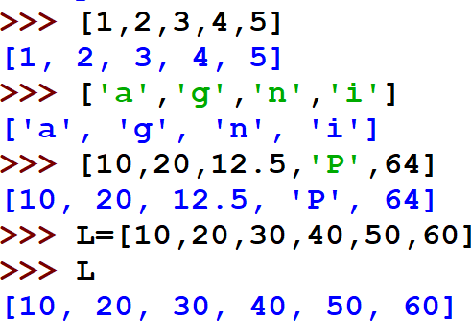
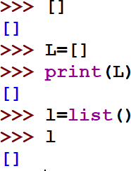
CREATION of LIST
CONTENTS
→Lists Intro:
List Definition Indexing in a List
Creation of a list
Traversal of a list
→Operations on a list
→Functions/methods
→ Lists Slicing;
→ Nested lists;
→finding the maximum,
minimum, mean
→ linear search on list
→ counting the frequency
List of numbers created without name
List of characters created without name List of mixed data type created without
name
List of numbers with name L
Empty List created without name
Empty List created with name L
Empty List created with name l using
funcion list()

Slide 7
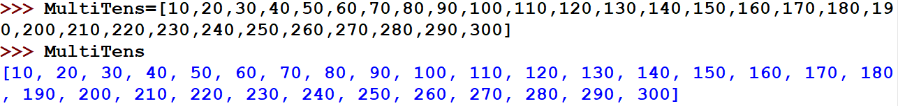

Creation of LIST contd.. (Long List and Nested List)
CONTENTS
→Lists Intro:
List Definition Indexing in a List
Creation of a list
Traversal of a list
→Operations on a list
→Functions/methods
→ Lists Slicing;
→ Nested lists;
→finding the maximum,
minimum, mean
→ linear search on list
→ counting the frequency
Creation of a long list with name MultiTens
Creation of a Nested List with name L
that is List inside a List

Slide 8

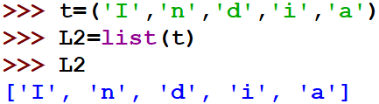
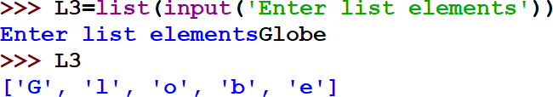
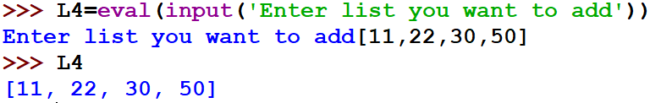
Creation of LIST from existing sequences
CONTENTS
Creating list from string Creating list from tuple
→Lists Intro:
List Definition
Indexing in a List
Creation of a list from string,tuple, list(input()),
eval(input())
Traversal of a list
Assign/change values in List
→Operations on a list
→Functions/methods
→ Lists Slicing;
→ Nested lists;
→finding the maximum,
minimum, mean
→ linear search on list
→ counting the frequency
Creating list by taking input from the keyboard(user)
**Note: All the elements are considered as string
Creating list by taking input from the keyboard [using eval()] ]method]
**Note: eval( ) identifies the type by looking at the given expression

Slide 9
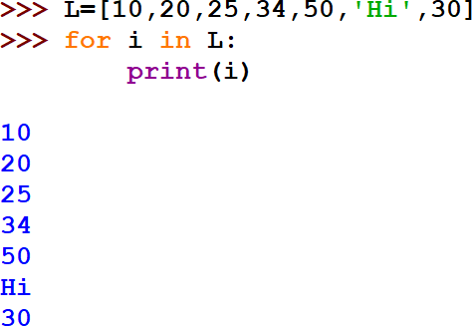
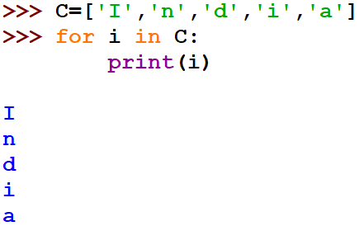
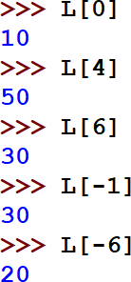
TRAVERSAL of a LIST
CONTENTS
→Lists Intro:
List Definition
Indexing in a List
Creation of a list
Traversal of a list
Assign /change values in List
→Operations on a list
→Functions/methods
→ Lists Slicing;
→ Nested lists;
→finding the maximum,
minimum, mean
→ linear search on list
→ counting the frequency

Slide 10
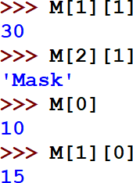
TRAVERSAL of NESTED LIST
CONTENTS
Enclosing List
→Lists Intro:
List Definition
Indexing in a List
Creation of a list
Traversal of a list
Assign /change values in List
→Operations on a list
→Functions/methods
→ Lists Slicing;
→ Nested lists;
→finding the maximum,
minimum, mean
→ linear search on list
→ counting the frequency
Nested List 1
Nested List 2
Note: Denoting Nested elements
using Index nos.
M[0] → 10 M[1] → [15,30]
M[1][0]→15
M[1][1]→30
M[2]→ *80,’Mask’,60+
M[2][0]→80 M[2][1]→‘Mask’ M[2][2]→60

Slide 11
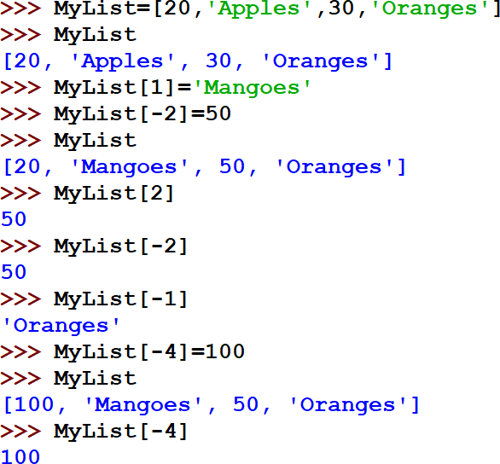
Assign/Change values in a LIST
Forward Index→
0
-4
1
-3
2 3
-2 -1 →Backward index
CONTENTS
→Lists Intro:
List Definition
Indexing in a List Creation of a list Traversal of a list
Assign /change values in List
→Operations on a list
→Functions/methods
→ Lists Slicing;
→ Nested lists;
→finding the maximum,
minimum, mean
→ linear search on list
→ counting the frequency
Assigning
/ Changing values of elements of a List
Assigning / Changing values of elements of a List

Slide 12





Slide 13
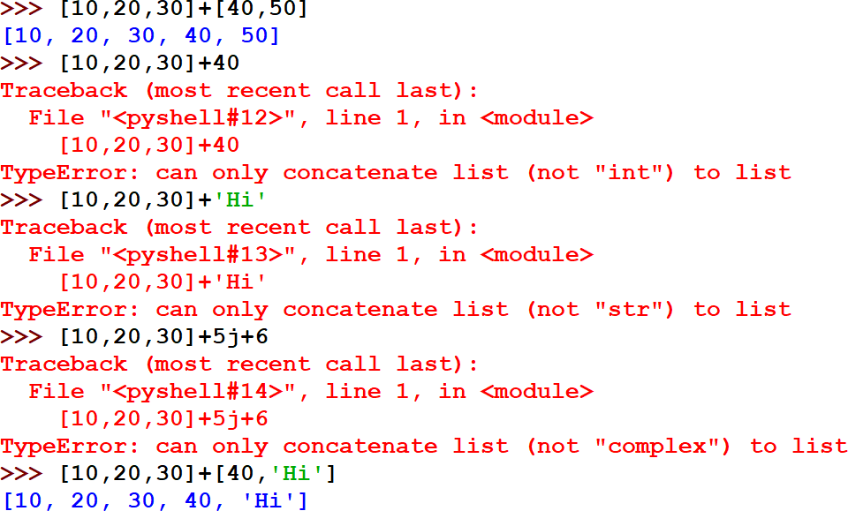
OPERATIONS on LIST Concatenation
CONTENTS
List CAN be concatenated or joined with another List
→Lists Introduction:
→OPERATIONS
ON List
Concatenation/Joining
Repetition/Replication Membership Comparison of Lists
→Functions/methods
→ Lists Slicing;
→ Nested lists;
→finding the maximum,
minimum, mean
→ linear search on list
→ counting the frequency
List CANNOT be concatenated with a number
List CANNOT be concatenated with a string
List CANNOT be joined with a complex nos.
Concatenation refers to Joining of two objects
List CAN be concatenated or joined with another List

Slide 14
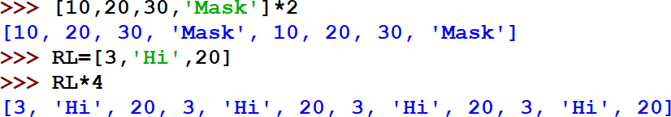
OPERATIONS on LIST Replication
CONTENTS
Replication refers to Repetition of objects as it is. Here, in LIST we can see NON-VECTORISED operation with a list where the entire list as a whole is replicated.
NOTE: Vectorised operation, refers to the replication of individual elements of the object.
→Lists Introduction:
→OPERATIONS
ON List
Concatenation/Joining
Repetition/
Replication
Membership Comparison of Lists
→Functions/methods
→ Lists Slicing;
→ Nested lists;
→finding the maximum,
minimum, mean
→ linear search on list
→ counting the frequency
Replicating the unnamed List two times
Replicating the named List RL four times

Slide 15


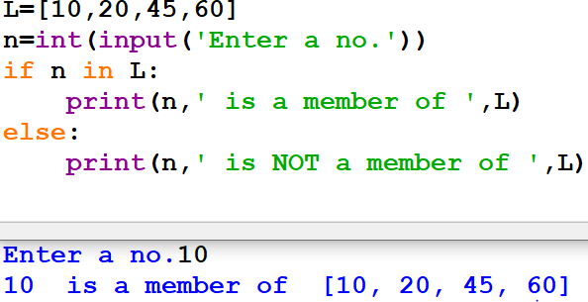
OPERATIONS on LIST Membership
CONTENTS
Membership operator tests for Membership in a sequence.
Returns Boolean True or False
→Lists Introduction:
→OPERATIONS
ON List
Concatenation/Joining Repetition/ Replication
Membership in List
Comparison of Lists
→Functions/methods
→ Lists Slicing;
→ Nested lists;
→finding the maximum,
minimum, mean
→ linear search on list
→ counting the frequency
OPERATOR | DESCRIPTION
in | Results to True value if it finds a variable at the LHS of in operator in the sequence mentioned in the RHS of the in operator, else it returns False
not in | Results to True value if it does not find a variable at the LHS of in operator in the sequence mentioned in the RHS of the in operator, else it returns False

Slide 16
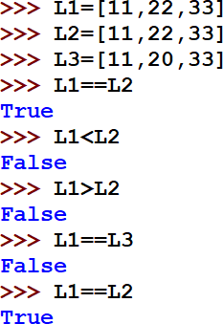

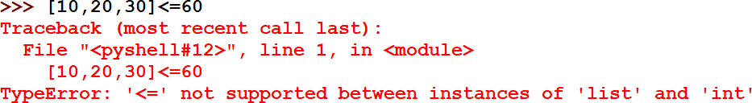
OPERATIONS on Comparison of LIST
CONTENTS
Comparison of list returns Boolean True or False.
→Lists Introduction:
→OPERATIONS
ON List
Concatenation/Joining Repetition/ Replication Membership in List
Comparison of Lists
→Functions/methods
→ Lists Slicing;
→ Nested lists;
→finding the maximum,
minimum, mean
→ linear search on list
→ counting the frequency
Relational operators
==,!=,<,<=,>,>= are used
in comparing two objects. Here, for example two List objects are compared.
Relational operators ==,!= can be used in comparing two objects eg. List with number/string/tuple. But, Relational operators
<,<=,>,>= always returns ERROR when used in comparing two objects eg.
List with number/string/tuple.
Eg. List CANNOT be
compared with a number

Slide 17














Slide 18
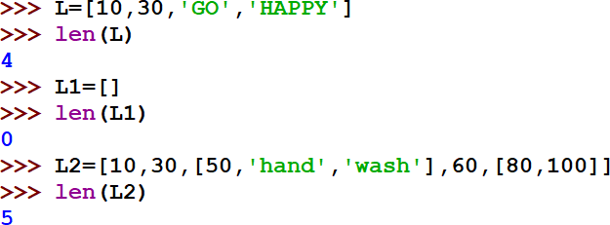

Functions / Methods on LIST-len()
CONTENTS
len() function counts the no. of elements in the List
→Lists Introduction:
→Operations on a list
→Functions/ methods
len(), list(),append(),
extend(), insert(), count(),index(), remove(),
pop(), reverse(), sort(),
min(), max(), sum(),clear()
→ Lists Slicing;
→ Nested lists;
→finding the maximum,
minimum, mean
→ linear search on list
→ counting the frequency
TOTAL 5 elements of the List object

Slide 19
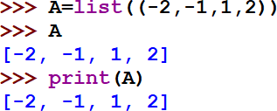
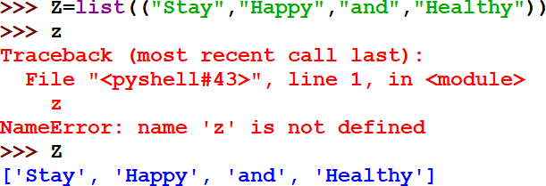
Functions / Methods on LIST-list()
CONTENTS
The list() function creates a list object.
A list object is a collection which is ordered and
changeable.
→Lists Introduction:
→Operations on a list
→Functions/ methods
len(), list(),append(),
extend(), insert(), count(),index(), remove(),
pop(), reverse(), sort(),
min(), max(), sum(),clear()
→ Lists Slicing;
→ Nested lists;
→finding the maximum,
minimum, mean
→ linear search on list
→ counting the frequency
list() function takes elements/values inside the parantheses i.e. ()
NOTE: Python language is case-sensitive.
Here, Z is the List object , so, z in small letters gives an error.

Slide 20
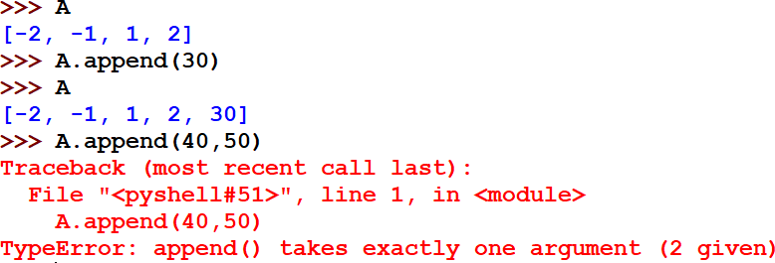

Functions / Methods on LIST-append()
CONTENTS
The append() function takes one single parameter and adds exactly one element at the end of the List. It takes exactly one element and returns no value.
→Lists Introduction:
→Operations on a list
→Functions/ methods
len(), list(),append(),
extend(), insert(), count(),index(), remove(), pop(), reverse(), sort(),min(), max(), sum(),clear()
→ Lists Slicing;
→ Nested lists;
→finding the maximum,
minimum, mean
→ linear search on list
→ counting the frequency
Here, append() function takes one single
parameter . In this example, 30.

Slide 21
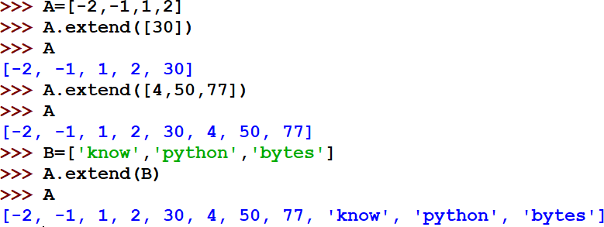
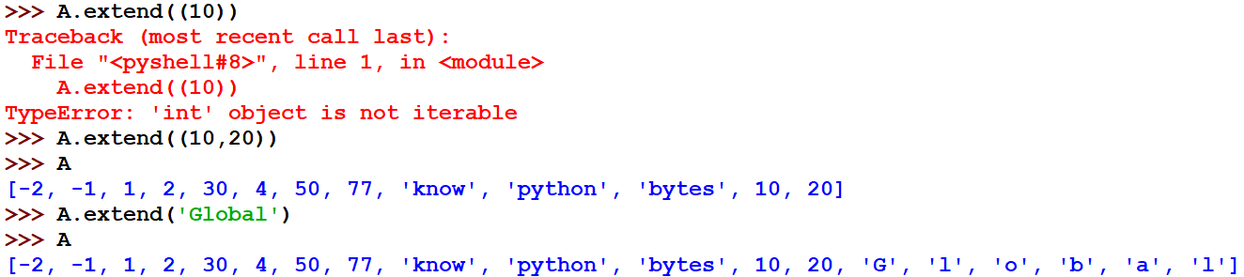
Functions / Methods on LIST-extend()
CONTENTS
The extend() function adds iterable (Eg. Another List/
→Lists Introduction:
→Operations on a list
→Functions/methods
len(), list(),append(), extend(), insert(), count(),index(), remove(),
pop(), reverse(), sort(),
min(), max(), sum(),clear()
→ Lists Slicing;
→ Nested lists;
→finding the max,min, mean
→ linear search on list
→ counting the frequency
Tuple/String) at the end of the List.
Here, trying to extend list A , with another
unnamed List containing one element [30].
Here, trying to extend list A , with another unnamed List containing three elements [4,50,77].
Here, trying to extend list A , with another named List B containing three elements
*‘know’,’python’,’bytes’+
Here, trying to extend list A , with a number 10. Hence error !!!
NOTE: A no. inside parentheses () is not a tuple, until it ends with a comma ,
Here, trying to extend list A , with an unnamed tuple with two values
Here, trying to extend list A , with a string.
Every character is considered as an element of the list.

Slide 22
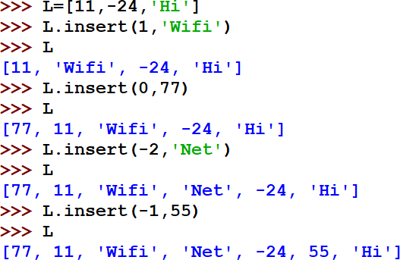
Functions / Methods on LIST- insert()
CONTENTS
insert( ) method,
inserts an item / element at a given position. It takes two arguments and returns no value. ListObject.insert(<position>,<item>)
Position denotes the index no.
Item denotes the item/element/value to be inserted.
→Lists Introduction:
→Operations on a list
→Functions/methods
len(), list(),append(), extend(),
insert(), count(),index(),
remove(), pop(), reverse(),
sort(),min(), max(),
sum(),clear()
→ Lists Slicing;
→ Nested lists;
→finding the maximum,
minimum, mean
→ linear search on list
→ counting the frequency
Forward Index→ | 0 | 1 | 2
 | -3 | -2 | -1
→Backward index
NOTE: Whenever the element is inserted, whether forward or backward index… it is always inserted at the left hand side of the current index item’s position.
Prepended→ inserted at the beginning i.e. index 0
Appended → inserted at the last

Slide 23
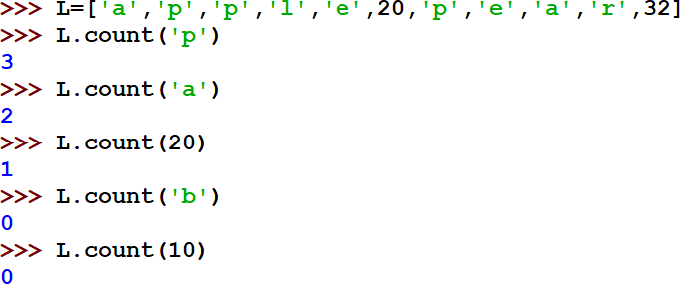
Functions / Methods on LIST- count()
CONTENTS
count( ) method,
returns the count of the item (no. of times the item /element/value appears) that is passed as argument. If the given item is not in the list, it will return 0
→Lists Introduction:
→Operations on a list
→Functions/ methods
len(), list(),append(), extend(), insert(),
count()
,index(),remove(), pop(),
reverse(), sort(),min(),
max(), sum(), clear()
→ Lists Slicing;
→ Nested lists;
→finding the maximum,
minimum, mean
→ linear search on list
→ counting the frequency

Slide 24
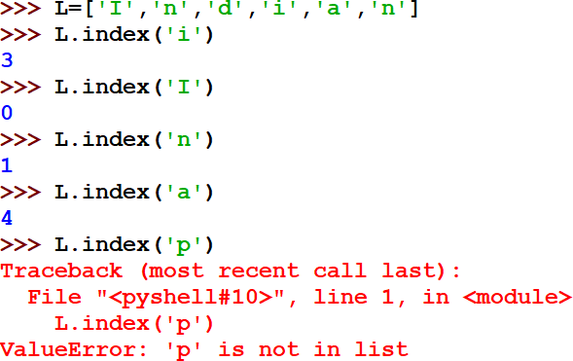
Functions / Methods on LIST- index()
CONTENTS
index( ) method,
returns the index of the first matched item.
→Lists Introduction:
→Operations on a list
→Functions/ methods
len(), list(),append(), extend(),
insert(),count(), index(),
remove(), pop(), reverse(),
sort(),min(), max(), sum() , clear()
→ Lists Slicing;
→ Nested lists;
→finding the maximum,
minimum, mean
→ linear search on list
→ counting the frequency
Forward Index→
0 1 2 3 4 5

Slide 25
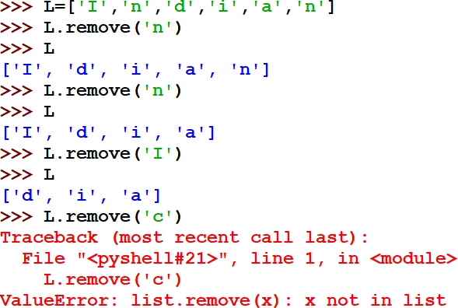
Functions / Methods on LIST- remove()
remove( ) method,
removes the first occurrence of given item from the list (from left-to-right)
remove( ) will report an error if there is no such value.
CONTENTS
→Lists Introduction:
→Operations on a list
→Functions/ methods
len(), list(),append(), extend(),
insert(),count(),index(), remove(), pop(), reverse(), sort(),min(), max(), sum() , clear()
→ Lists Slicing;
→ Nested lists;
→finding the maximum,
minimum, mean
→ linear search on list
→ counting the frequency

Slide 26
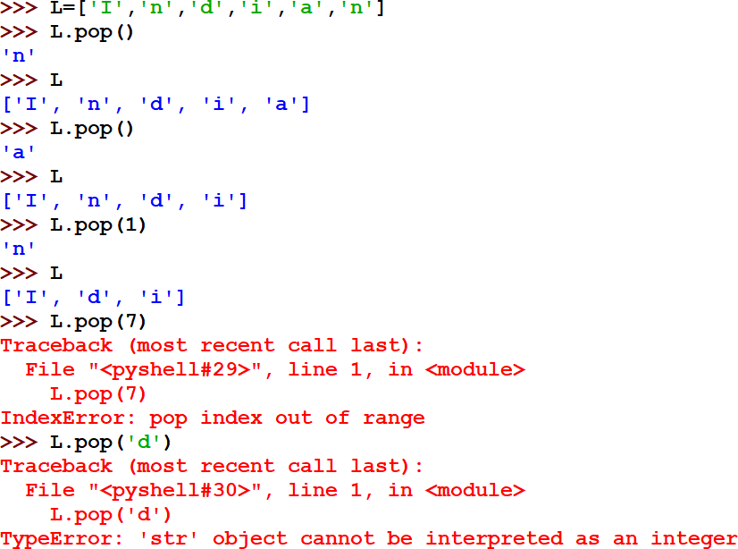
Functions / Methods on LIST- pop()
CONTENTS
pop( ) method is used to remove the item from the list.
It takes one optional argument . The element being deleted is returned by the method
→Lists Introduction:
→Operations on a list
→Functions/ methods
len(), list(),append(), extend(), insert(),count(),index(),
remove(), pop(),
reverse(), sort(),min(),
max(), sum() , clear()
→ Lists Slicing;
→ Nested lists;
→finding the maximum, minimum, mean
→ linear search on list
→ counting the frequency
 | DIFFERENCE between pop() and remove() The pop( ) method removes an individual item (from the right most end → by default) or the value/element present at the index number mentioned in the parameter and returns it. Whereas remove( ) searches the first occurrence of the item and removes it from the list

Slide 27
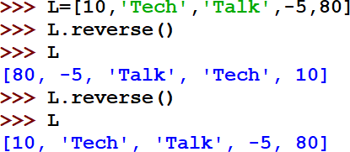
Functions / Methods on LIST- reverse()
CONTENTS
→Lists Introduction:
→Operations on a list
→Functions/ methods
len(), list(),append(), extend(),
insert(),count(),index(), remove(), pop(), reverse(), sort(),min(),
max(), sum(),clear()
→ Lists Slicing;
→ Nested lists;
→finding the maximum,
minimum, mean
→ linear search on list
→ counting the frequency
reverse( ) method,
reverses the items of the list.
This doesn’t create a new list.
It takes no argument and return no list. Reverses the list ‘in place’ and does not return anything.

Slide 28
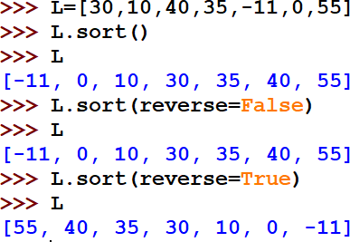
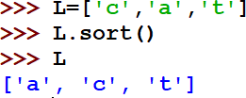
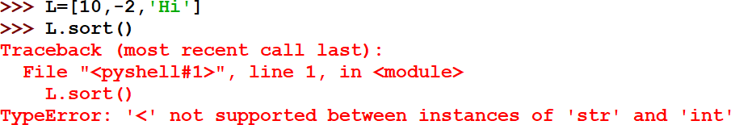
Functions / Methods on LIST- sort()
CONTENTS
sort( ) method,
sort( ) method and sort(reverse=True ) sorts or orders the items of the list, by default in increasing order. sort(reverse=True ) for getting the list in decreasing order
→Lists Introduction:
→Operations on a list
→Functions/ methods
len(), list(),append(), extend(), insert(),count(),index(),
remove(), pop(), reverse(),
sort(),min(), max(),
sum() , clear()
→ Lists Slicing;
→ Nested lists;
→finding the maximum,
minimum, mean
→ linear search on list
→ counting the frequency
NOTE: The sort( ) method won’t be able to sort the values of a list if it contains complex numbers/tuple
/ mixed datatype as its elements.

Slide 29
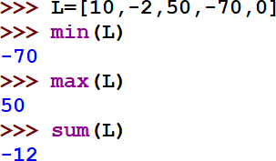
Functions / Methods on LIST- min(),max(),sum()
CONTENTS
→Lists Introduction:
min( ) method,
Returns the minimum out of the elements/values/items of the given List
→Operations on a list
→Functions/ methods
len(), list(),append(), extend(), insert(),count(),index(),
remove(), pop(), reverse(),
sort(),min(),
max(), sum(),
clear()
→ Lists Slicing;
→ Nested lists;
→finding the maximum,
minimum, mean
→ linear search on list
→ counting the frequency
max( ) method,
Returns the maximum out of the elements/values/items of the given List
sum( ) method,
Returns the sum of all the values/elements/items of the given List.

Slide 30
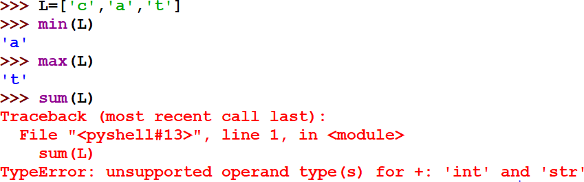


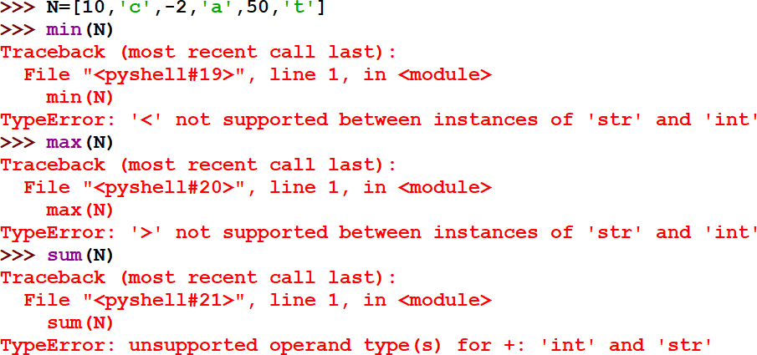









Functions / Methods on LIST- min(),max(),sum() contd..
List of string . Maximum and Minimum is done on the basis of the ASCII values of the characters from the beginning.
Eg. ‘A’=65, ‘a’ = 97, ‘b’=98
and so on
A List with mixed data type cannot return values for the min, max and sum functions.

Slide 31



Functions / Methods on LIST- clear()
CONTENTS
→Lists Introduction:
→Operations on a list
→Functions/ methods
len(), list(),append(), extend(), insert(),count(),index(),
remove(), pop(), reverse(),
sort(),min(), max(), sum() ,
clear()
→ Lists Slicing;
→ Nested lists;
→finding the maximum,
minimum, mean
→ linear search on list
→ counting the frequency
clear( ) method,
removes all the items from the list and the list becomes empty after executing this function.

Slide 32





Slide 33
LIST slicing
L[start:stop] creates a list slice out of list L with elements falling between indexes start and stop, not including value at the stop index.
L[start:stop:step] creates a list slice out of list L with elements falling between indexes start and stop, not including value at the stop index, and skipping step elements in between.
NOTE: In absence of any start, stop, step values, we have Default start index as the beginning, stop index as the last index and step value as +1.
F O R W A R D
I N D E X
D I R E C T I O N
0 | 1 | 2 | 3 | 4 | 5 | 6 | 7 | 8 | 9 | 10 | 11 | 12 | 13 | 14
K | N | O | W | P | Y | T | H | O | N | B | Y | T | E | S
-15 | -14 | -13 | -12 | -11 | -10 | -9 | -8 | -7 | -6 | -5 | -4 | -3 | -2 | -1
B A C K W A R D
I N D E X
D I R E C T I O N

Slide 34
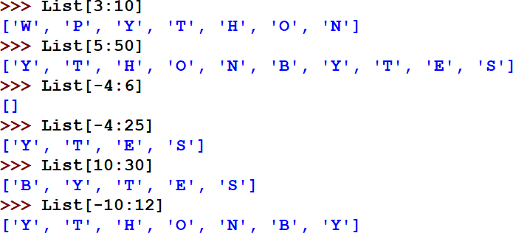
LIST slicing
0 | 1 | 2 | 3 | 4 | 5 |  | 6 | 7 | 8 | 9 |  | 10 | 11 | 12 | 13 | 14
K | N | O | W | P | Y |  | T | H | O | N |  | B | Y | T | E | S
-15 | -14 | -13 | -12 | -11 | -10 |  | -9 | -8 | -7 | -6 |  | -5 | -4 | -3 | -2 | -1
Start index 3, stop index is (10-1=9)
Start index 5, stop index is 50 which is beyond the last index in forward direction. Hence, it will stop at the last index
Start index -4(backward), stop index is (6-1=5 (forward)). Here, it is not getting any value in the range, hence empty.
Start index -4(which is ‘Y’ as per the backward index,) stop index is 25
which is beyond the last index. Hence, it will stop at the last index.
Start index 10, stop index is 30 which is beyond the last index in forward direction. Hence, it will stop at the last index
Start index -10(which is ‘Y’ as per the backward index,) stop index is 12-1=11 (forward indexing). Hence, it will stop at the (stop index-1)., ‘Y’ is at 11 index no.

Slide 35
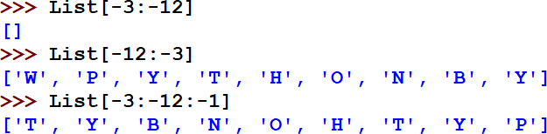
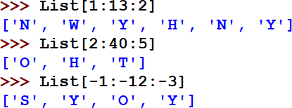


LIST SLICING contd.
0 | 1 | 2 | 3 | 4 | 5 | 6 | 7 | 8 | 9 | 10 | 11 | 12 | 13 | 14
K | N | O | W | P | Y | T | H | O | N | B | Y | T | E | S
-15 | -14 | -13 | -12 | -11 | -10 | -9 | -8 | -7 | -6 | -5 | -4 | -3 | -2 | -1
Start index -3(backward), stop index is -12(backward). Here, it is not getting
any value in the range as no step value mentioned in reverse. Hence empty.
Start index -12(which is ‘W’ as per the backward index,) stop index is -3 (which takes values till index -3-1= -4)
Start index -3(backward), stop index is -12(backward). Here, it is getting
value in the range as step value is -1 mentioned in reverse.
Start index -20(which is beyond backward index,) stop index is -5 which takes value till (-5-1=-6). Here, -6 is ‘N’.
Start index 1, stop index is 13 (till 13-1=12),step value is 2 in forward direction. Hence, it will fetch/take alternate elements with a skip of 1 value in between
?
TRY TO UNDERSTAND YOURSELF. A task for you.
Also write the slice for List to get the output as
Default start and stop is beginning and end index of the list. Here, step is 3.

Slide 36







Slide 37
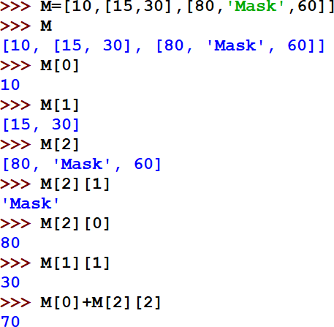
NESTED LISTS
CONTENTS
Enclosing List
→Lists Intro
→Operations on a list
→Functions/methods
→ Lists Slicing;
→ Nested lists;
→finding the maximum,
minimum, mean
→ linear search on list
→ counting the frequency
Nested List 1
Nested List 2
Note: Denoting Nested elements
using Index nos.
M[0] → 10 M[1] → [15,30]
M[1][0]→15
M[1][1]→30 M[2]→ *80,’Mask’,60+
M[2][0]→80 M[2][1]→‘Mask’ M[2][2]→60

Slide 38






Slide 39
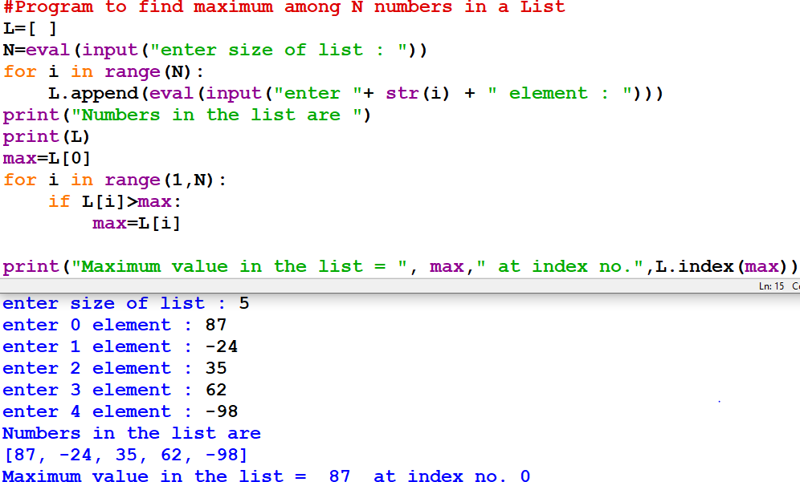
Program to find the MAXIMUM element from a list of element along with its index in the list without using max() library function
CONTENTS
→Lists Intro
→Operations on a list
→Functions/ methods
→ Lists Slicing;
→ Nested lists;
→finding the
maximum
, minimum, mean
→ linear search on list
→ counting the frequency
OUTPUT

Slide 40
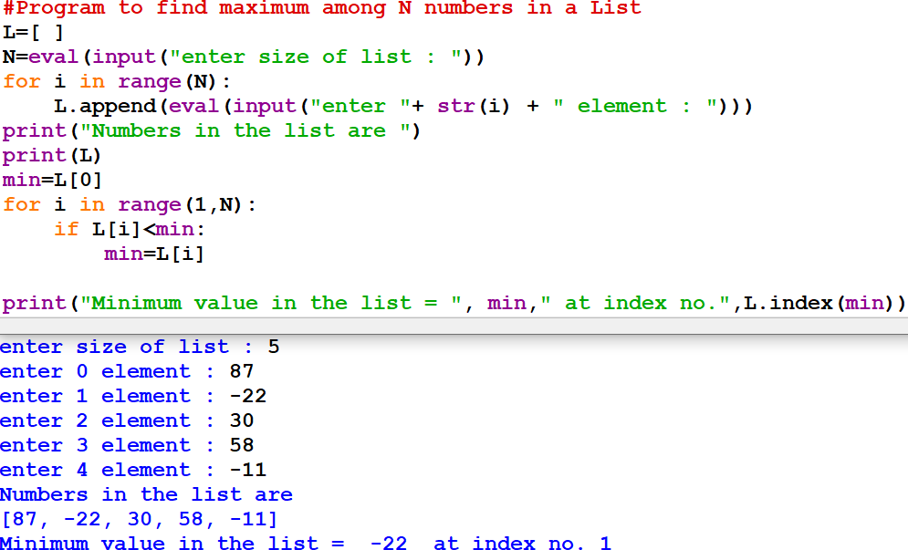
Program to find the MINIMUM element from a list of element along with its index in the list without using min() library function
CONTENTS
→Lists Intro
→Operations on a list
→Functions/ methods
→ Lists Slicing;
→ Nested lists;
→finding the
minimum,
maximum , mean
→ linear search on list
→ counting the frequency
OUTPUT

Slide 41
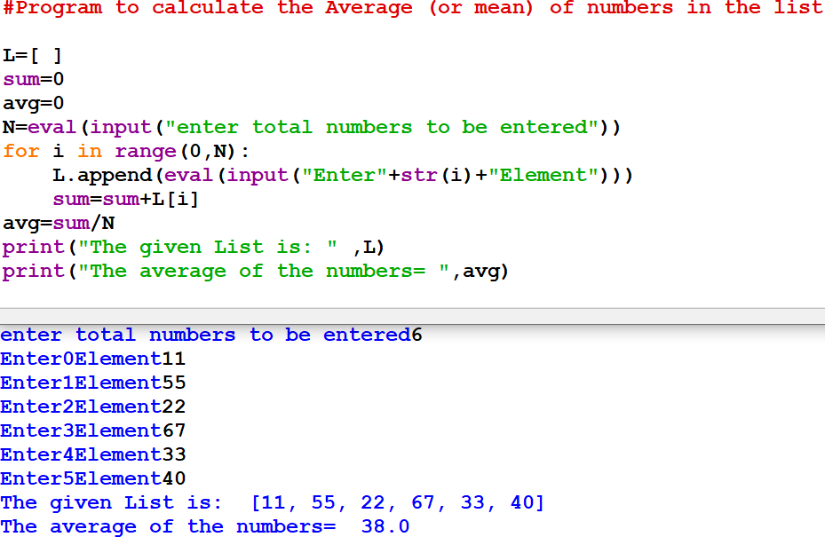
Program to find the MEAN (AVERAGE) of all the elements of the list
CONTENTS
→Lists Intro
→Operations on a list
→Functions/ methods
→ Lists Slicing;
→ Nested lists;
→finding the mean,
maximum,
minimum
→ linear search on list
→ counting the
frequency
OUTPUT

Slide 42
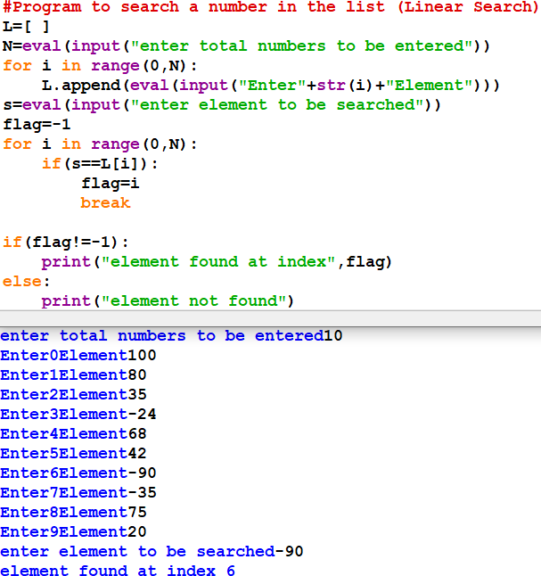
Program to search an element in the List (LINEAR SEARCH)
CONTENTS
→Lists Intro
→Operations on a list
→Functions/
methods
→ Lists Slicing;
→ Nested lists;
→finding the mean, maximum, minimum
→ linear search on
list
→ counting the frequency
OUTPUT

Slide 43
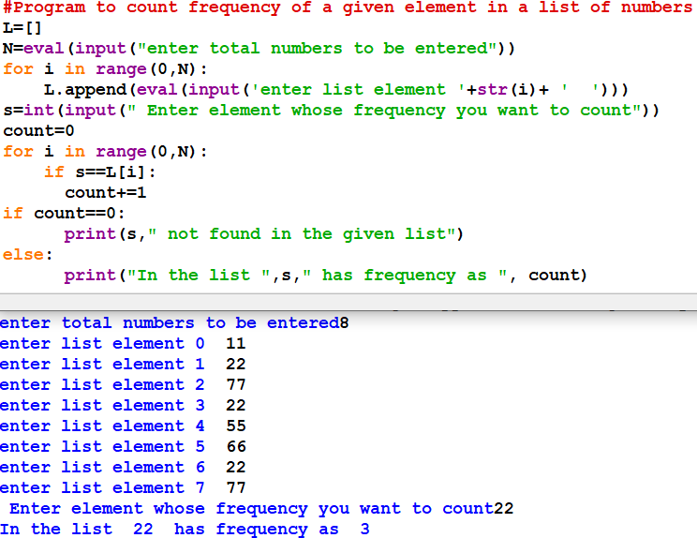
Program to count frequency (/no. of times of occurrence) of an element in the List
(FREQUENCY COUNT)
CONTENTS
→Lists Intro
→Operations on a list
→Functions/
methods
→ Lists Slicing;
→ Nested lists;
→finding the mean, maximum, minimum
→ linear search on list
→
counting the frequency
OUTPUT

Slide 44
Bibliograhy and References
Google
Wikipedia
XI Computer Science , By Sumita Arora, Dhanpat Rai Publication 2020 Edition
XI Informatics Practices , By Sumita Arora, Dhanpat Rai Publication 2020 Edition

Slide 45
Programming is an ART….
Add your colours to it and make your own

